Slide 1
^{Chapter 2} Abstract Data Types
Zaman University
Data Structures and Algorithms

Slide 2
Outline
Stacks
Queues and Priority Queues
Linked Lists
Abstract Data Types
Specialized Lists

Slide 3
Outline
Stacks
Queues and Priority Queues
Linked Lists
Abstract Data Types
Specialized Lists

Slide 4
Queues
The word queue is British for line (the kind you wait in)
In computer science a queue is a data structure that is similar to a stack, but in a queue the First In, the First Out (FIFO)

Slide 5

Queues: How Does It Work?
A queue works like the line at the movies
The first person to join the rear of the line is the first person to reach the front of the line and buy a ticket
The last person to line up is the last person to buy a ticket
People join the queue at the rear
People leave the
queue at the front

Slide 6
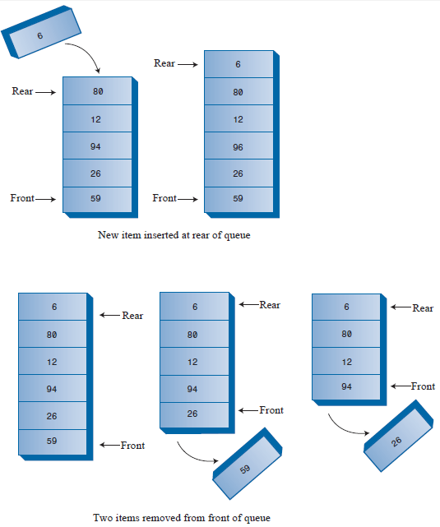
Queue: Insert and Remove Operations

Slide 7
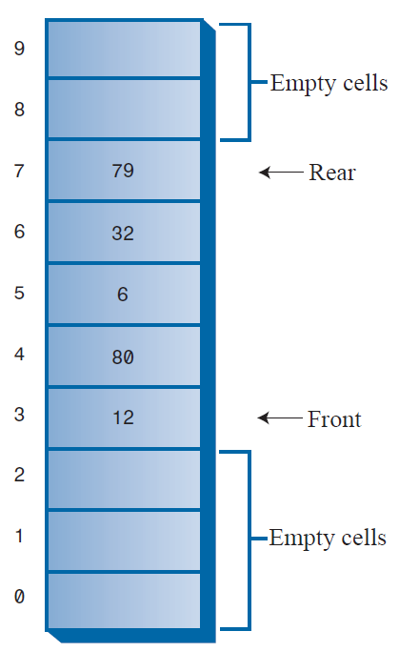
Queue: Some Items Removed
MaxSize-1

Slide 8
Queue: The Empty and Full Error
In case, there are no more items in the queue, you cannot remove an item from queue
In case, all the cells are already occupied, you cannot insert a new item to queue

Slide 9
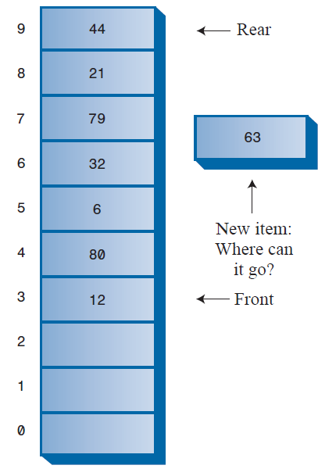
Circular Queue¹
MaxSize-1
To Avoid the problem of not
being able to insert more items
into the queue even when
it’s not full
the Front and Rear arrows
wrap around to the beginning
of the array.
The result is a circular queue
(sometimes called a ring buffer).

Slide 10
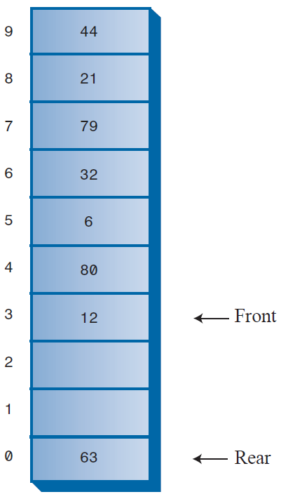
Circular Queue²
Insert a few more items
The Rear arrow moves upward as you would expect.
After Rear has wrapped around, it’s now below Front, the reverse of the original arrangement.
This broken sequence: the items in the queue are in two different sequences in the array.
Delete enough items
The Front arrow also wraps around
Back to the original arrangement, with Front below Rear
The items are in a single contiguous sequence.

Slide 11
#define DEF_SIZE 10 //Define Maximum Size of Array (stack)
class CMyQueue{ //class CMyQueue
private:
int QueueMaxSize; //Size of Queue Array
int Array[ DEF_SIZE ]; //Queue Array
int Rear; //Rear of Queue
int Front; //Front of Queue
int ItemNumber; //Number Items of Queue
public:
void InitMyQueue(); //Function initiation StackMaxSize and Top
bool IsFull(); //Function to check, is the Queue full? true - full
void Insert( int NewItem ); //Function to Insert a new item to the Rear of Queue
bool IsEmpty(); //Function to check, is the Queue empty? true - empty
void Remove(); //Function to remove item from the front of Queue
int Size(); //Function to return the number of elements in the Queue
int PeekFront(); //Function to read item value from the front of the Queue
};
void CMyQueue::InitMyStack(){
StackMaxSize = DEF_SIZE;
Rear = -1; //Initiation value of Rear is -1
Front = 0;
ItemNumber = 0;
};
bool CMyQueue::IsFull(){
if( ItemNumber == StackMaxSize-1 ) return true; //return true if the Queue if true
else return false; //otherwise, return false
};
void CMyQueue::Insert( int NewItem ){
if( !IsFull() ){ //check, if the Queue is NOT full
if( Rear == QueueMaxSize-1 ) //Deal with wrap around
Rear = -1;
Rear++; //Move Top up (increase)
Array[ Rear ] = NewItem; //Add new item to the top of Queues
ItemNumber++; //Increase Number Item in Queue
cout << “Insert New Item Successfully";
}
else cout << “The Queue is full"; //if the stack is full
};

Slide 12

Create a Queue with the full operations: Insert, Remove, PeekFront, size, isEmpty, isFull

Slide 13
Priority Queues
A priority queue is a more specialized data structure than a stack or a queue
It is useful tool in a surprising number of situations
Like an ordinary queue, a priority queue has a front and a rear, and items are inserted in the rear and removed from the front
In a priority queue, items are ordered by key value, so that the item with the lowest key (or highest key) is always at the front
Items are inserted in the proper position to maintain the order

Slide 14
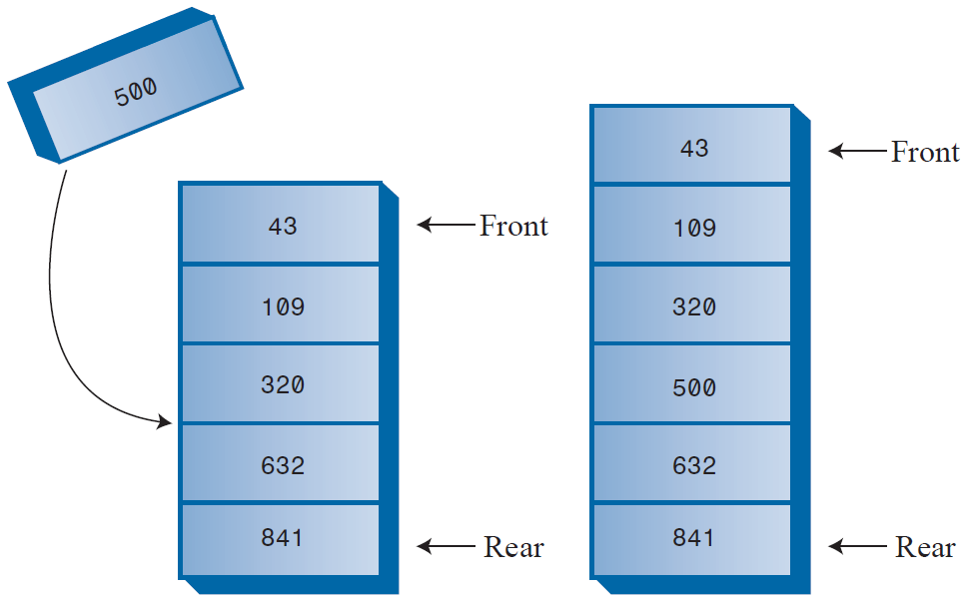
Priority Queues: Inserting a New Item
Notice that there is no wraparound in implementation of the priority queue
Insertion is slow because the proper in-order position must be found, but deletion is fast
Firstly, find the appropriate position by his value
Insert a new item to the found position

Slide 15
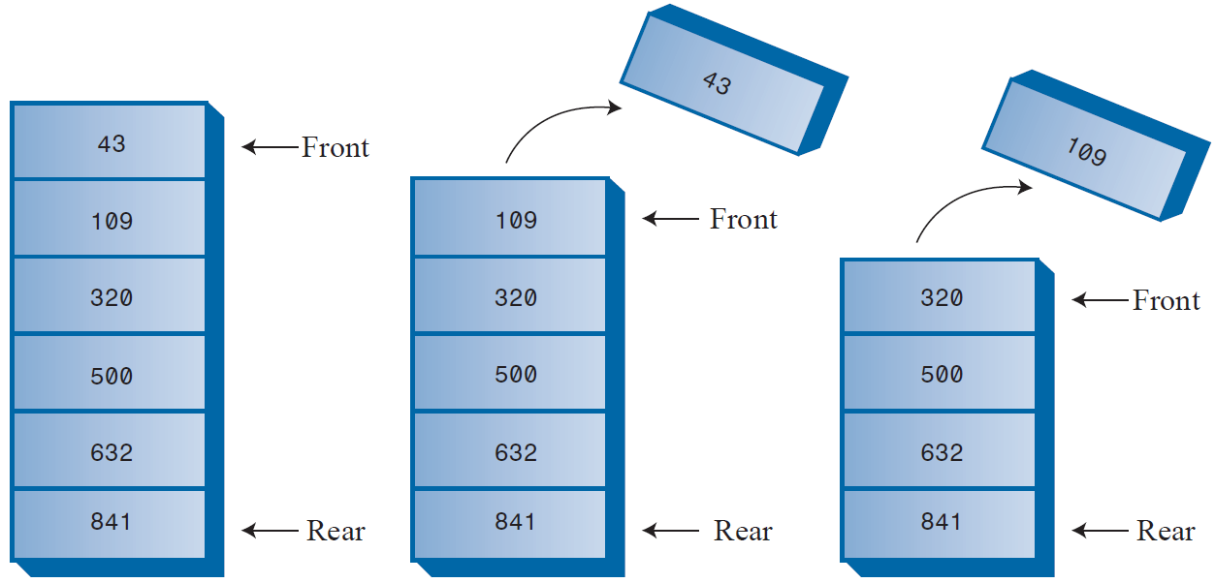
Priority Queues: Deleting an Item
The item to be removed is always the front item (in both ascending and descending), thus removal is quick and easy
The item is removed and the Front moves to the next item of the array
No comparisons or shifting are necessary

Slide 16
Priority Queues: Priority Queues in C++
class CMyPriorQueue{ //Array is sorted order, from max at 0 to min at ItemNumber-1
int Array[ DEF_SIZE ]; //PQ Array
int QueueMaxSize; //Size of PQ
int ItemNumber; //Item Number of PQ
public:
void InitPriorQueue(); //Function for initiation QueueMaxSize and ItemNumber
bool IsFull(); //Function to check, is the PQ full? true - full
void InsertPQ( int NewItem ); //Function to Insert NewItem to PQ
void RemovePQ(); //Remove the first item from PQ
bool IsEmptyPQ(); //Check, is the PQueue empty?
int SizePQ(); //Return ItemNumber
int PeekFrontPQ(); //Read, value of the front item (Min or Max)
};
void CMyPriorQueue::InitPriorQueue(){
QueueMaxSize = DEF_SIZE; //Init value of QueueMaxSize and ItemNumber
ItemNumber = 0;
};
void CMyPriorQueue::InsertPQ(int NewItem){
if( ItemNumber == 0 ){ //If the PQ is Empty
Array[ ItemNumber ] = NewItem; //Insert NewItem and increase ItemNumber
ItemNumber++;
}else{ //if the PQ is not Empty
if( ItemNumber < QueueMaxSize ){ //if the PQ is not full
int i;
for( i=ItemNumber-1; i >= 0; --i ){
if( NewItem > Array[ i ] ) //Define the appropriate position by value of NewItem
Array[ i+1 ] = Array[ i ];
else break; //Found the appropriate position for the NewItem
}
Array[ i+1 ] = NewItem; //Insert NewItem
ItemNumber++; //Increase ItemNumber
}else cout << "The PQ is full!"; //In case, the PQ is full
}
};

Slide 17
Create Priority Queue (ascending and descending) with full operations: IsFull(), InsertPQ( int NewItem ), RemovePQ(), IsEmptyPQ(), SizePQ(), and PeekFrontPQ().
Read book of Robert Lafore, page: 146– 165 for next lecture

Slide 18
To be continued…

